Slide 1
Interactive Kea Game
Anne Meyer, Jake Sebald, Joe Leanza, and Zach Allison

Slide 2
About Us and Main Division of Work
Computer Science:
Anne Meyer: meyer3ay@mail.uc.edu
Software/Programming
Project Management
Jake Sebald: sebaldjm@mail.uc.edu
Software/Programming
Data Collection
Computer Engineering:
Joe Leanza: leanzaja@mail.uc.edu
Hardware
Reward System
Electrical Engineering:
Zach Allison: allisozk@mail.uc.edu
Hardware
Installation/Train Kea
Project Advisor:
Dieter Vanderelst: vanderdt@ucmail.uc.edu
Cincinnati Zoo Contact:
Kathryn Kalafut: kkalafut@gmail.com

Slide 3
Project Description - Abstract
The Interactive Kea project intends to create a system that allows the Cincinnati zoo guests to interact with the Kea birds by playing a game together. The Kea are intelligent birds capable of continuously learning new activities. The project will reward the Kea for their efforts while simultaneously collecting data for research. The data gathered will allow the Cincinnati Zookeepers to learn potentially new things regarding the Kea. The system will need to be safe to interact with for both the guests of all ages and for the Kea. The system itself will consist of one monitor for the guests and one for the birds, allowing them to interact at the same time.

Slide 4
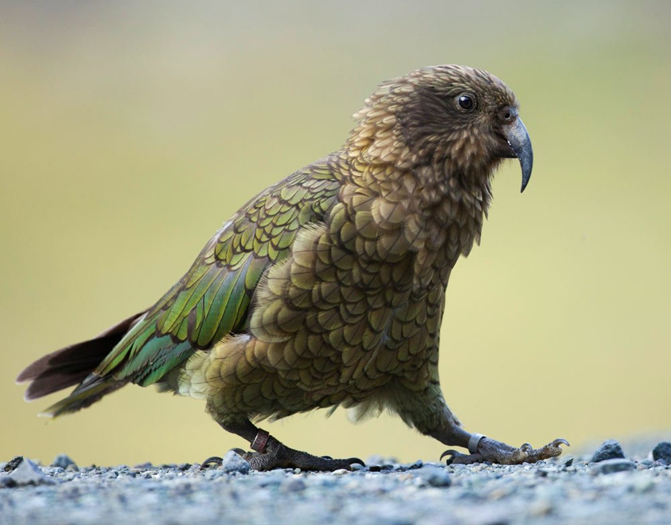
About Our Project
Kea
Intelligent birds
Native to New Zealand
Purpose:
Provide research data
Interactive game for Kea and guests
Goal:
Design and build a game that the Kea can learn to participate in with the Zoo guests
Capture data about the Kea

Slide 5
Timeline of Milestones
11/5 - Design Wired Prototype and Begin to Program Game
11/19 - Implement Wired Prototype
11/26 Design Wireless Prototype and Finalize Game
11/26 Train Kea with Wired Prototype
1/28 - Implement Wireless Prototype and Program Data Collection
2/4 - Install Game at Zoo
3/1 - Create Demo and Presentation

Slide 6
Project Description – User Stories
As a Zookeeper…
I need a device to entertain Kea birds and to test its intellectual ability so I can collect data on them.
As a Cincinnati Zoo guest…
I need a way to interact with the Kea birds so I can see their intellectual ability.
I need a way for the birds to be rewarded for playing with the device so that they can be trained on the device.
As the Cincinnati Zoo…
I need the device to be safe for the Kea birds, so they do not destroy it and/or get hurt by the device.

Slide 7
Project Description – Constraints
Requires specialized expertise
Safety of the Kea birds
Outdoor system/Weatherproof
Reprogrammable/Replaceable hardware
Compact movable design

Slide 8
Project Progress
Current/Completed
Expected Accomplishments this term
Met with Zoo staff and Kea birds
Established and approved the game portion
Created a prototype design
Hardware purchasing and budgeting
Constructing the first prototype
Train the Kea with the system
Identifying and correcting issues
Redesign system

Slide 9
Project Demo
Video of the birds interacting with the system and receiving a reward
A monitor that allows users to:
Access our program
Play our games against each other

